Slide 1

Physics Presentation
- Jack Cleary – A00269640

Slide 2
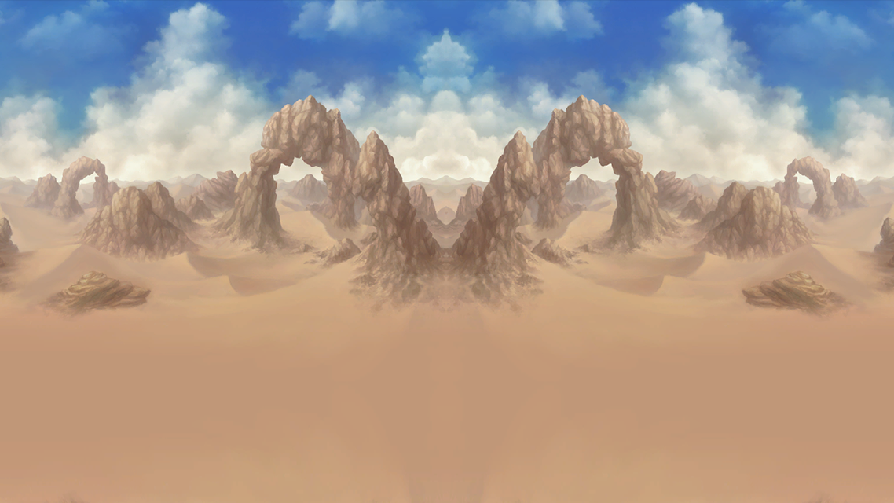
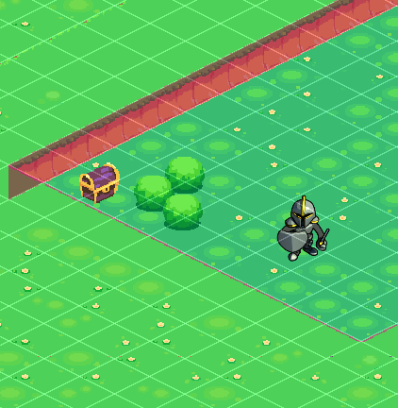
Colliders
Colliders are present throughout Redeemer’s Crusade in the form of level boundaries, world objects, enemies and the player themselves.
In the image to the right, level boundary colliders are denoted in red. The bushes, chest and player also have colliders present.

Slide 3
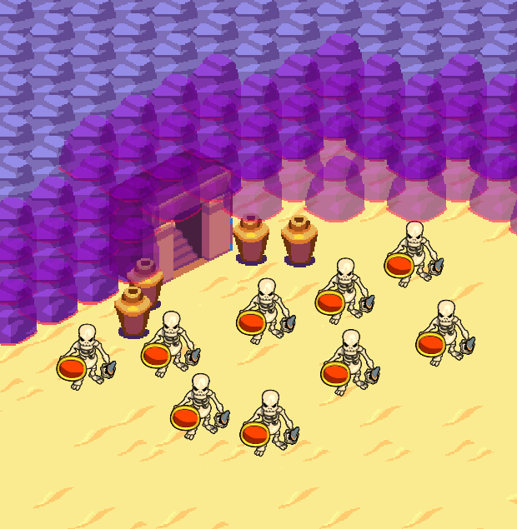
Triggers
Triggers are present throughout Redeemer’s Crusade in the form of hitboxes and at the end of levels.
In the image to the right, the door with stairs is a trigger. It only allows the player to pass when they have reached the correct amount of points.

Slide 4
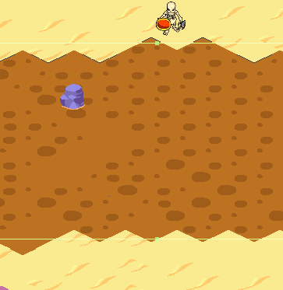
Effectors
An area effector is present in Redeemer’s Crusade in the form of quicksand.
In the image to the right, the brown area is connected to an area effector (green outline), where if the player or an enemy walks within it, it alters their speed.

Slide 5
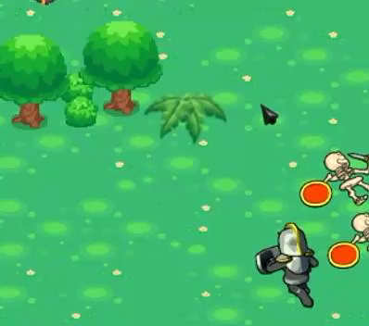
Joints
Joints are present within Redeemer’s Crusade in the form of moveable objects.
In the gif to the right, the plant moves around its hinge when contacted by the player.

